Slide 1
Logistic Regression II
Model Performance.
Josh Hug and Lisa Yan

Slide 2
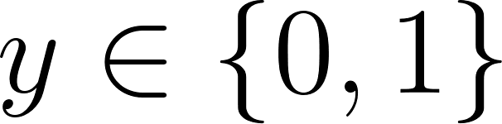
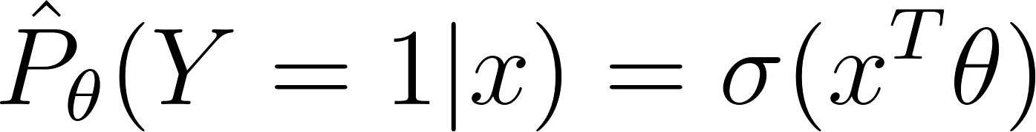
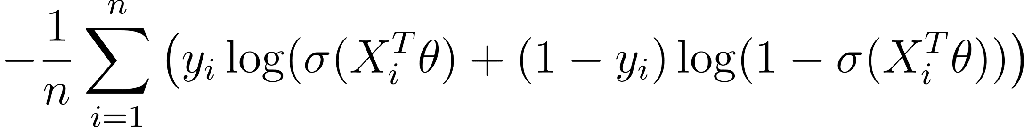
Logistic Regression with sklearn
(documentation)
from sklearn.linear_model import LogisticRegression
model = LogisticRegression(fit_intercept=False)
model.fit(X, Y)
Task/Model
Binary Classification ( )
Fit to objective function
Average Cross-Entropy Loss
+ regularization
For logistic regression, sklearn applies regularization by default.
We’ll see why soon.

Slide 3
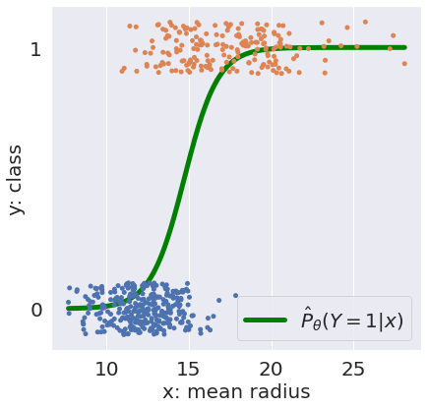
Sklearn: Predict Probabilities
model.predict_proba(X) # probs for all classes
model.classes_ # array([0, 1])

Slide 4
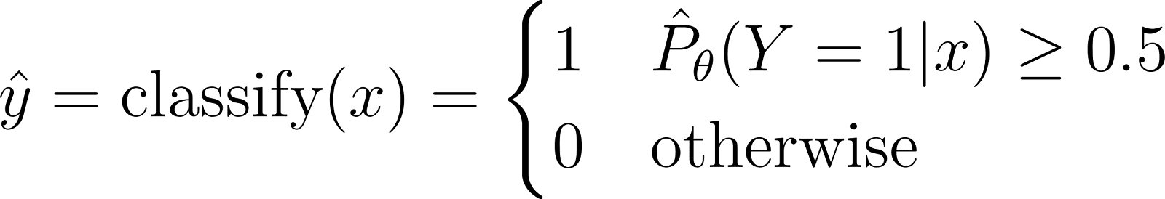
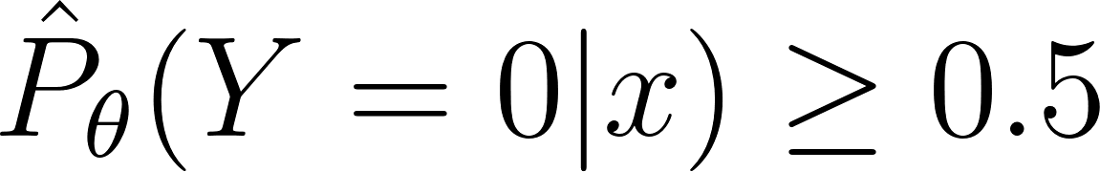
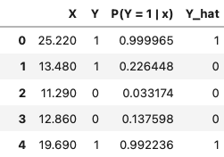
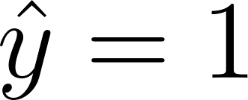
Sklearn: Classification
model.predict_proba(X) # probs for all classes
model.classes_ # array([0, 1])
model.predict(X) # predict 1 or 0
Equivalent “otherwise” condition:
Interpret: Given the input feature x: If Y is more likely to be 1 than 0, then predict . Else predict 0.

Slide 5
Logistic Regression with sklearn
(documentation)
from sklearn.linear_model import LogisticRegression
model = LogisticRegression(fit_intercept=False)
model.fit(X, Y)
Task/Model
Binary Classification ( )
Fit to objective function
Average Cross-Entropy Loss
+ regularization
Why does sklearn always apply regularization?

Slide 6
Performance Metrics
Logistic Regression Model, continued
sklearn demo
Maximum Likelihood Estimation: high-level (live), detailed (recorded)
Linear separability and Regularization
Performance Metrics
Accuracy
Imbalanced Data, Precision, Recall
Adjusting the Classification Threshold
A case study
ROC curves, and AUC
[Extra] Detailed MLE, Gradient Descent, PR curves

Slide 7
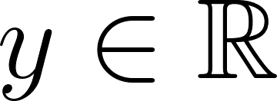
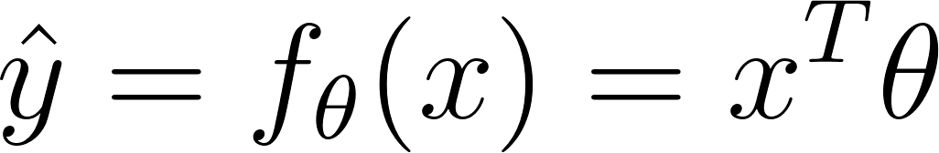
Next Time
Regression ( )
Classification ( )
✅
1. Choose a model
Linear Regression
Logistic Regression
✅
2. Choose a loss function
Average Cross-Entropy Loss
Squared Loss or Absolute Loss
3. Fit the model
Regularization Sklearn/Gradient descent
Regularization Sklearn/Gradient descent
4. Evaluate model performance
Let’s do it!
R², Residuals, etc.

Slide 8

Classifier Accuracy
Now that we actually have our classifier, let’s try and quantify how well it performs.
The most basic evaluation metric for a classifier is accuracy.
def accuracy(X, Y):
return np.mean(model.predict(X) == Y)
accuracy(X, Y) # 0.8691
model.score(X, Y) # 0.8691
(sklearn documentation)
While widely used, the accuracy metric is not so meaningful when dealing with class imbalance in a dataset.

Slide 9
Pitfalls of Accuracy: A Case Study
Suppose we’re trying to build a classifier to filter spam emails.
Each email is spam (1) or ham (0).
Let’s say we have 100 emails, of which only 5 are truly spam, and the remaining 95 are ham.
Your friend (“Friend 1”):
Classify every email as ham (0).
What is the accuracy of your friend’s classifier?
Is accuracy a good metric of this classifier’s performance?
🤔

Slide 10
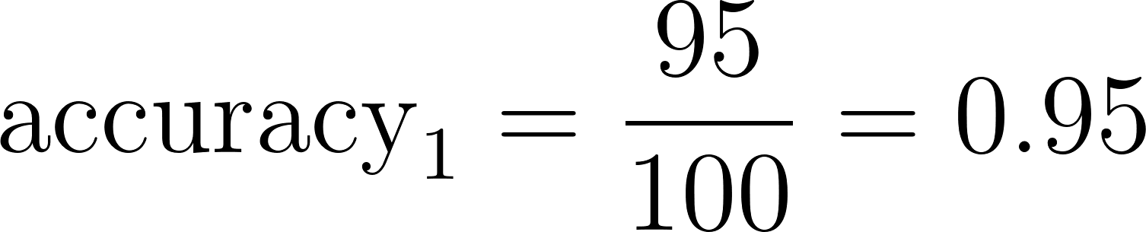
Pitfalls of Accuracy: A Case Study
Suppose we’re trying to build a classifier to filter spam emails.
Each email is spam (1) or ham (0).
Let’s say we have 100 emails, of which only 5 are truly spam, and the remaining 95 are ham.
Your friend (“Friend 1”):
Classify every email as ham (0).
High accuracy… …but we detected none ⚠️ of the spam!!!

Slide 11
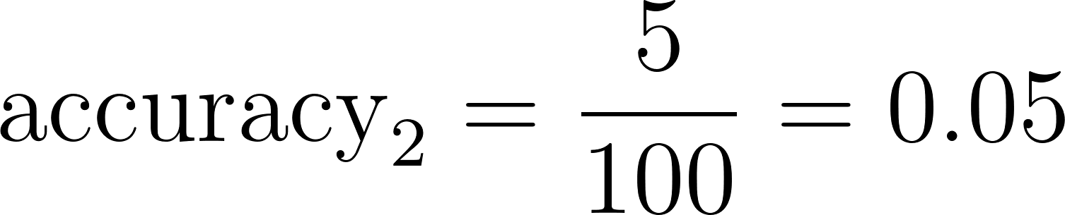
Pitfalls of Accuracy: A Case Study
Suppose we’re trying to build a classifier to filter spam emails.
Each email is spam (1) or ham (0).
Let’s say we have 100 emails, of which only 5 are truly spam, and the remaining 95 are ham.
Your friend (“Friend 1”):
Classify every email as ham (0).
Your other friend (“Friend 2”):
Classify every email as spam (1).
High accuracy… …but we detected none ⚠️ of the spam!!!
Low ⚠️ accuracy… …but we detected all of the spam!!!

Slide 12
Pitfalls of Accuracy: Class Imbalance
Suppose we’re trying to build a classifier to filter spam emails.
Each email is spam (1) or ham (0).
Let’s say we have 100 emails, of which only 5 are truly spam, and the remaining 95 are ham.
Accuracy is not always a good metric for classification, particularly when your data have class imbalance (e.g., very few 1’s compared to 0’s).
Your friend (“Friend 1”):
Classify every email as ham (0).
Your other friend:
Classify every email as spam (1).
High accuracy… …but we detected none ⚠️ of the spam!!!
Low ⚠️ accuracy… …but we detected all of the spam!!!

Slide 13


Types of Classification Successes/Errors: The Confusion Matrix
True positives and true negatives are when we correctly classify an observation as being positive or negative, respectively.
Prediction
 | 0 | 1
0 | True negative (TN) | False positive (FP)
1 | False negative (FN) | True positive (TP)
False positives are “false alarms”: we predicted 1, but the true class was 0.
False negatives are “failed detections”: we predicted 0, but the true class was 1.
Actual
“positive” means a prediction of 1. “negative” means a prediction of 0.

Slide 14
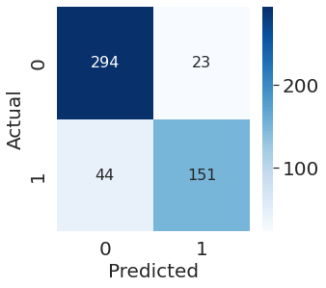
Types of Classification Successes/Errors: The Confusion Matrix
True positives and true negatives are when we correctly classify an observation as being positive or negative, respectively.
Prediction
 | 0 | 1
0 | True negative (TN) | False positive (FP)
1 | False negative (FN) | True positive (TP)
False positives are “false alarms”: we predicted 1, but the true class was 0.
False negatives are “failed detections”: we predicted 0, but the true class was 1.
Actual
A confusion matrix plots these four quantities for a particular classifier and dataset.
from sklearn.metrics import confusion_matrix
cm = confusion_matrix(Y_true, Y_pred)

Slide 15
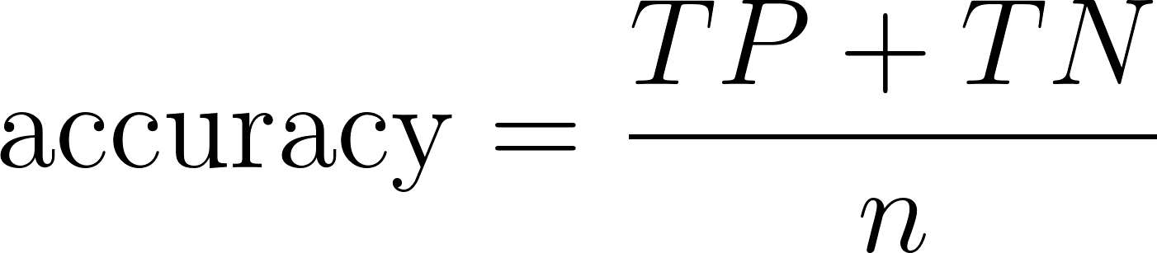
Accuracy, Precision, and Recall
Prediction
 | 0 | 1
0 | TN | FP
1 | FN | TP
What proportion of points did our classifier classify correctly?
Actual
Notes:
Precision captures the accuracy of the model when it is positive. Higher precision models are often more likely to predict that true things are negative (higher false negative rate).
Recall captures the ability of the model to predict true on all the true examples. Higher recall runs the risk of predicting true on false examples.

Slide 16
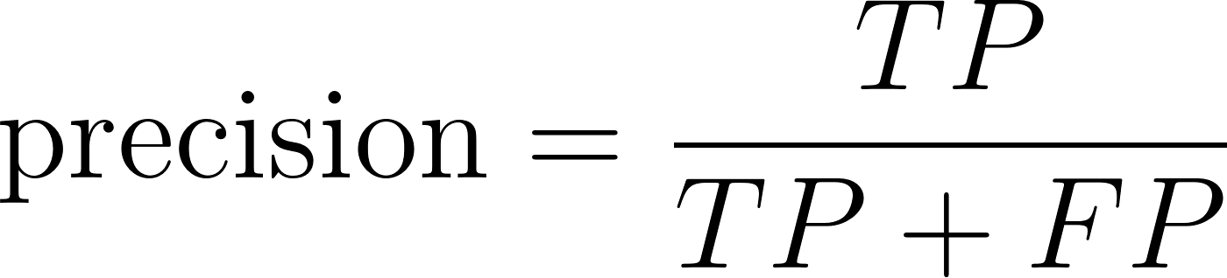
Accuracy, Precision, and Recall
Prediction
 | 0 | 1
0 | TN | FP
1 | FN | TP
What proportion of points did our classifier classify correctly?
Actual
Precision and recall are two commonly used metrics that, measure performance even in the presence of class imbalance.
Of all observations that were predicted to be 1, what proportion were actually 1?
How accurate is our classifier when it is positive?
Penalizes false positives.
Notes:
Precision captures the accuracy of the model when it is positive. Higher precision models are often more likely to predict that true things are negative (higher false negative rate).
Recall captures the ability of the model to predict true on all the true examples. Higher recall runs the risk of predicting true on false examples.

Slide 17
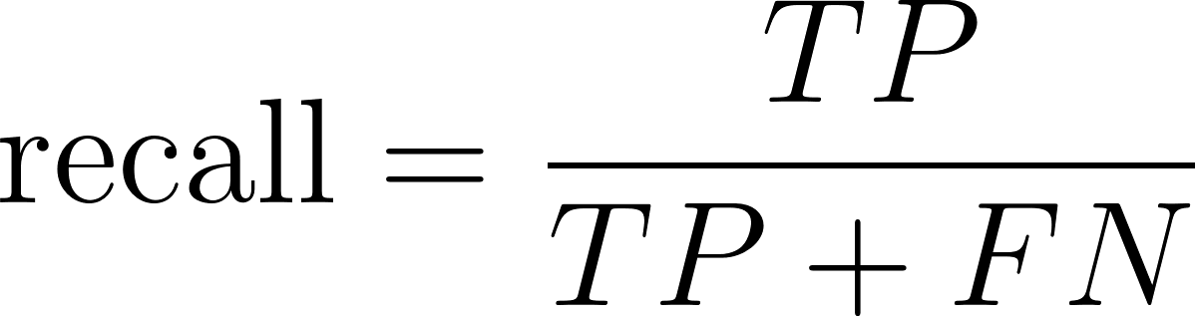
Accuracy, Precision, and Recall
Prediction
 | 0 | 1
0 | TN | FP
1 | FN | TP
What proportion of points did our classifier classify correctly?
Actual
Precision and recall are two commonly used metrics that, measure performance even in the presence of class imbalance.
Of all observations that were predicted to be 1, what proportion were actually 1?
How accurate is our classifier when it is positive?
Penalizes false positives.
Of all observations that were actually 1, what proportion did we predict to be 1? (Also known as sensitivity.)
How sensitive is our classifier to positives?
Penalizes false negatives.
Notes:
Precision captures the accuracy of the model when it is positive. Higher precision models are often more likely to predict that true things are negative (higher false negative rate).
Recall captures the ability of the model to predict true on all the true examples. Higher recall runs the risk of predicting true on false examples.

Slide 18
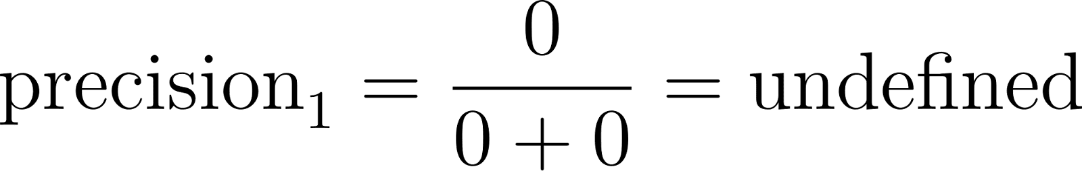
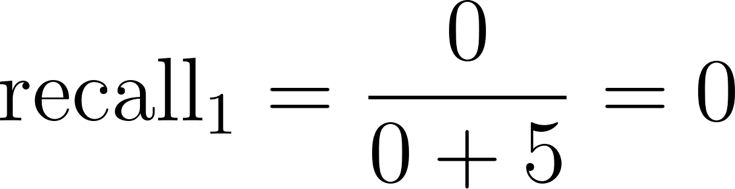
Back to the Spam
Suppose we’re trying to build a classifier to filter spam emails.
Each email is spam (1) or ham (0).
Let’s say we have 100 emails, of which only 5 are truly spam, and the remaining 95 are ham.
Your friend:
Classify every email as ham (0).
 | 0 | 1
0 | TN: 95 | FP: 0
1 | FN: 5 | TP: 0

Slide 19
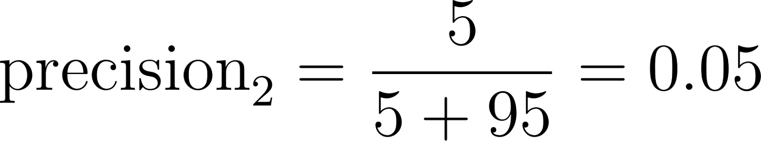
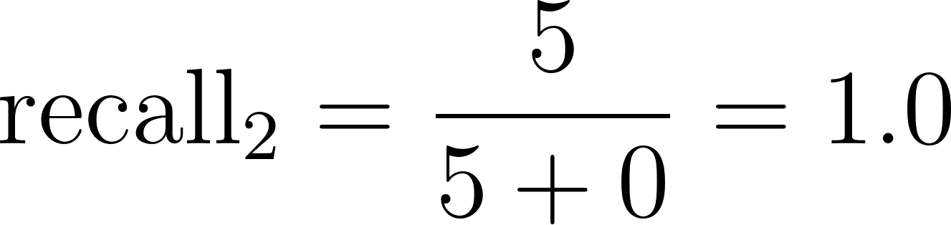
Back to the Spam
Suppose we’re trying to build a classifier to filter spam emails.
Each email is spam (1) or ham (0).
Let’s say we have 100 emails, of which only 5 are truly spam, and the remaining 95 are ham.
Your friend:
Classify every email as ham (0).
Your other friend (“Friend 2”):
Classify every email as spam (1).
 | 0 | 1
0 | TN: 0 | FP: 95
1 | FN: 0 | TP: 5
Many false positives!
Never positive!
No false negatives!

Slide 20
Which Performance Metric?
In many settings, there might be a much higher cost to missing positive cases. For our tumor classifier:
We really don’t want to miss any malignant tumors (avoid false negatives).
We might be fine with classifying benign tumors as malignant (OK to have false positives), since pathologists could do further studies to verify all malignant tumors.
This context would prioritize recall.
How do we engineer classifiers to meet the performance goals of our problem?
Notes:
On the other hand, for our spam email classifier:
Classification error “cost” is much more subjective.
Choosing between precision, recall, and accuracy depends what you think is worse:
Lots of spam emails in inbox? Avoid false negatives and prioritize recall.
Lots of non-spam (ham) emails marked as spam? Avoid false positives.

Slide 21
Adjusting the Classification Threshold
Logistic Regression Model, continued
sklearn demo
Maximum Likelihood Estimation: high-level (live), detailed (recorded)
Linear separability and Regularization
Performance Metrics
Accuracy
Imbalanced Data, Precision, Recall
Adjusting the Classification Threshold
A case study
ROC curves, and AUC
[Extra] Detailed MLE, Gradient Descent, PR curves

Slide 22
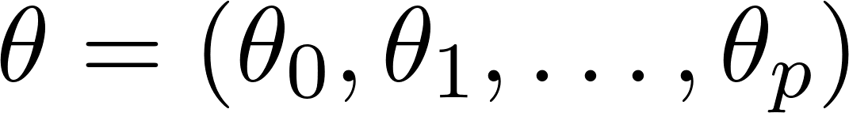


Engineering, Part 1: Deciding a Model
Feature Engineering:
What are the features x that generate great probabilities for prediction?
Parameter :
Probability of response = 1
observation vector
≈
classify
prediction
categorical response

Slide 23
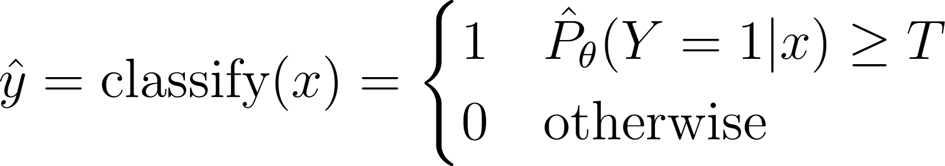
Engineering, Part 2: Deciding a Classification Threshold
Classification:
What is the best classification threshold T to choose that best fits our problem context?
Parameter :
Probability of response = 1
observation vector
≈
classify
sklearn’s model.predict() uses fixed 0.5
prediction
categorical response

Slide 24
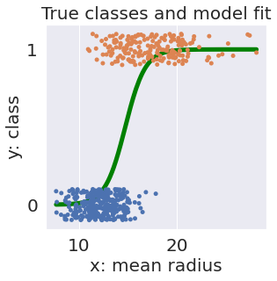
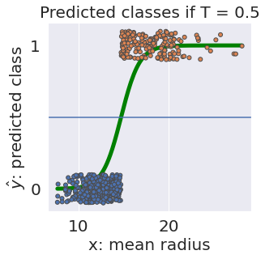
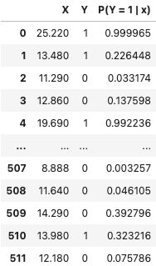
Classification Threshold
The default threshold in sklearn is T = 0.5.

Slide 25
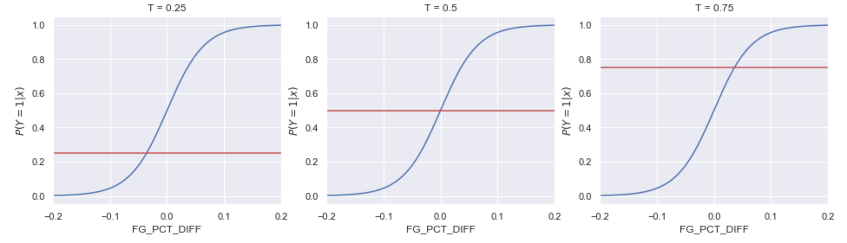
Classification Threshold
As we increase the threshold T, we “raise the standard” of how confident our classifier needs to be to predict 1 (i.e., “positive”).
T = 0.25
T = 0.50
T = 0.75
These x will all predict 1
Fewer positives

Slide 26
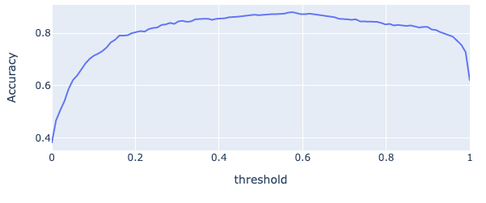

Choosing an Accuracy Threshold
The choice of threshold T impacts our classification performance.
High T: Most predictions are 0. Lots of false negatives.
Low T: Most predictions are 1. Lots of false positives.
Do we get max accuracy when T ≈ 0.5? Not always the case…
Train Accuracy vs. Threshold
T ≈ 0.57
Best T ≈ 0.57 likely due to class imbalance. There are fewer malgnant tumors and so we want to be more confident before classifying a tumor as malignant.

Slide 27
Choosing a Threshold According to Other Metrics?
The choice of threshold T impacts our classification performance.
High T: Most predictions are 0. Lots of false negatives.
Low T: Most predictions are 1. Lots of false positives.
Could we choose a threshold T based on metrics that measure false positives/false negatives?
Yes! Two options:
Precision-Recall Curve (PR Curve).
“Receiver Operating Characteristic” Curve (ROC Curve).
Each of these visualizations have an associated performance metric: AUC (Area Under Curve).

Slide 28
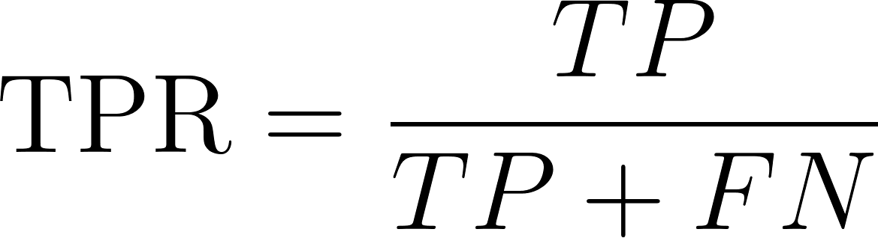
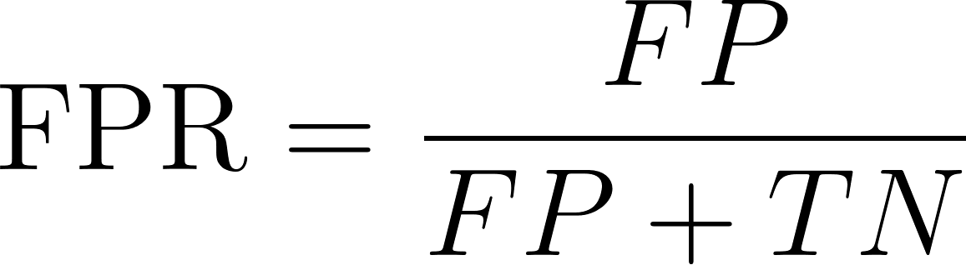
Two More Metrics
Prediction
 | 0 | 1
0 | TN | FP
1 | FN | TP
True Positive Rate (TPR):
“What proportion of spam did I mark correctly?
Same thing as recall. In statistics, sensitivity.
False Positive Rate (FPR):
“What proportion of regular email did I mark as spam?
In statistics, also called specificity.
The ROC curve plots TPR vs FPR for different classification thresholds.

Slide 29
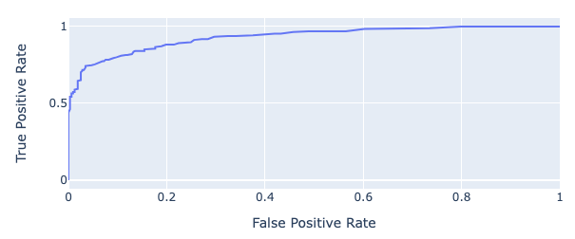
The ROC Curve
The ROC Curve plots this tradeoff.
ROC stands for “Receiver Operating Characteristic.” [Wikipedia]
We want high TPR, low FPR.
T = 0.1
T = 0.6
T = 0.9

Slide 30
Performance Metric: Area Under Curve (AUC)
The “perfect” classifier is the one that has a TPR of 1, and FPR of 0.
We want our model to match that as well as possible.
We want our ROC curve to be as close to the “top left” of this graph as possible.
Perfect Predictor
We can compute the area under curve (AUC) of our model.
Different AUCs for both ROC curves and PR curves, but ROC is more common.
Best possible AUC = 1. Terrible AUC = 0.5.
Random predictors have an AUC of around 0.5. Why?
Your model’s AUC: somewhere between 0.5 and 1.

Slide 31
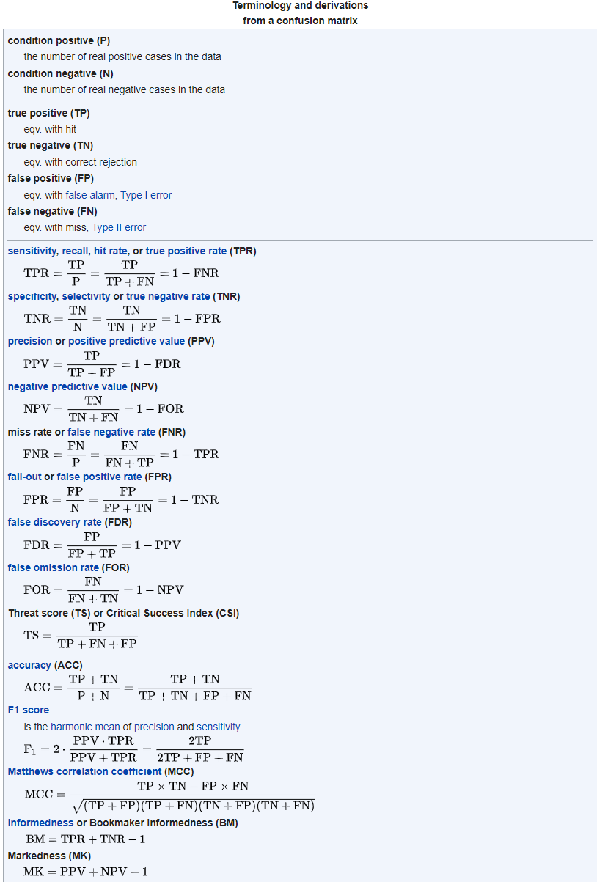
Common techniques for evaluating classifiers
Numerical assessments:
Accuracy, precision, recall/TPR, FPR.
Area under curve (AUC), for ROC curves.
Visualizations:
Confusion matrices.
Precision/recall curves.
ROC curves.
We’re only scratching the surface here.

